Slide 1



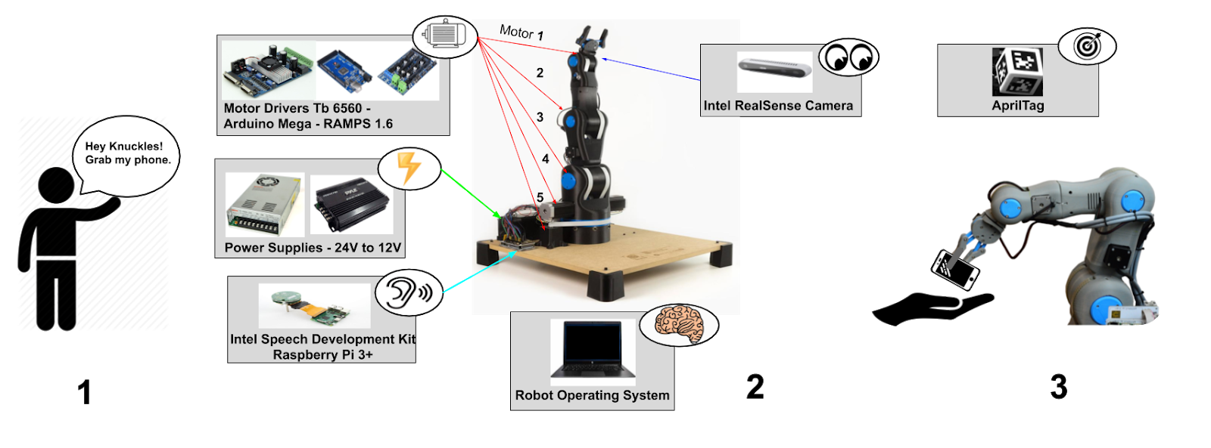
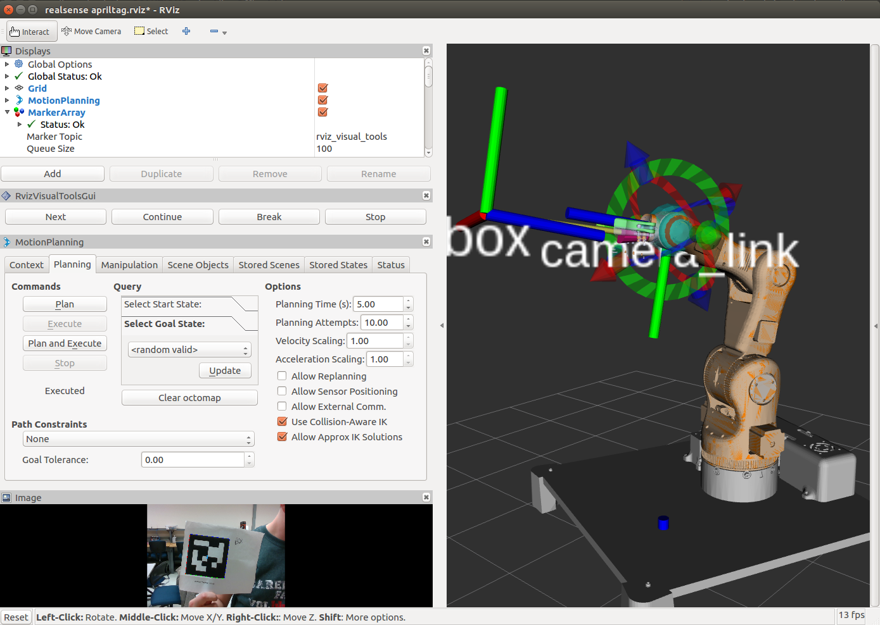
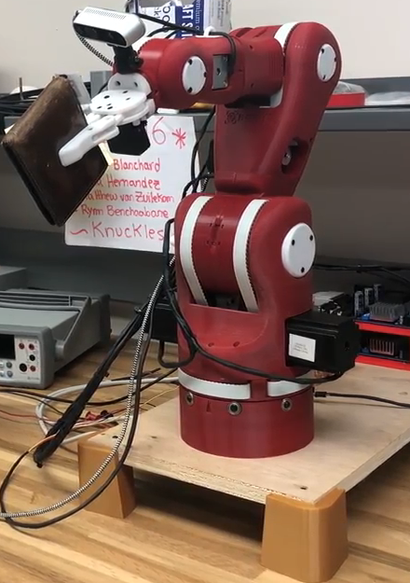
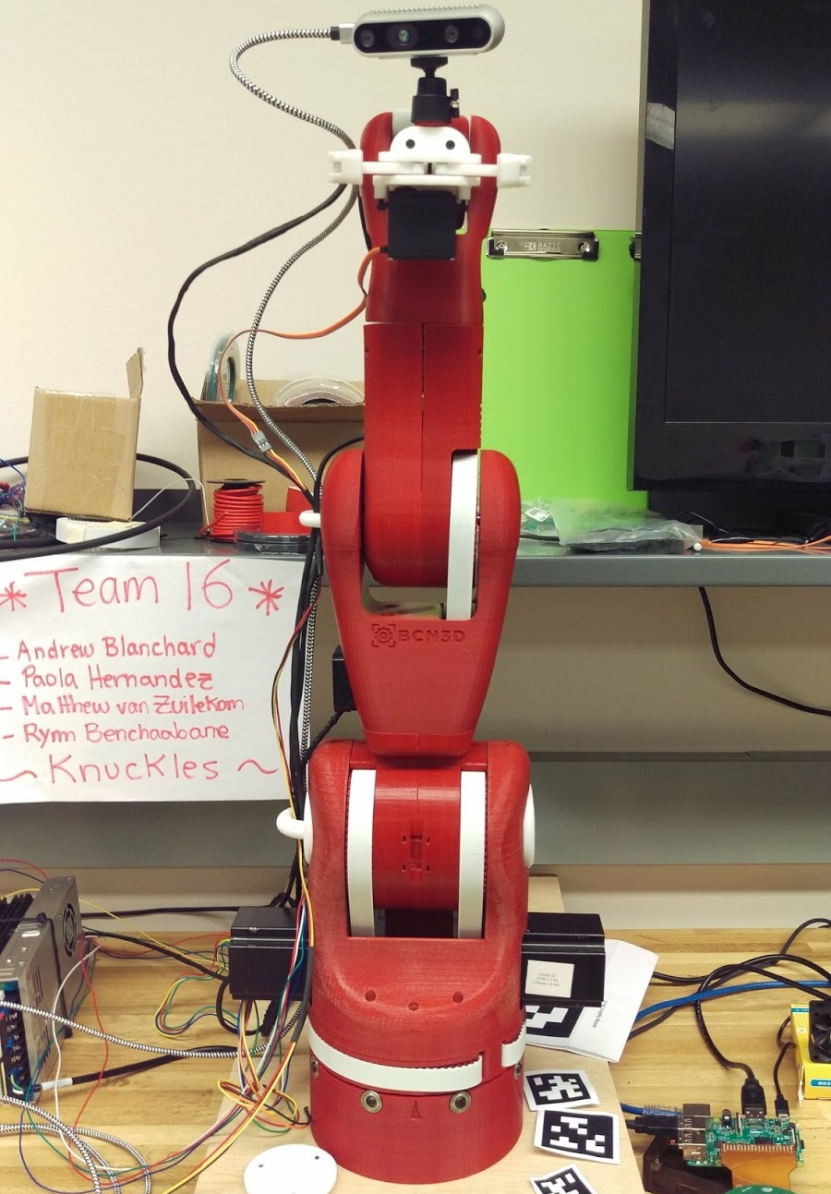
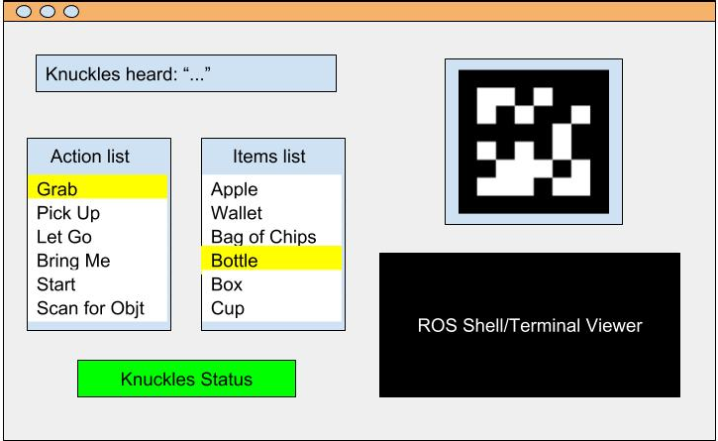
Knuckles, The Assistive Robotic Arm
Andrew Blanchard, Matthew van Zuilekom, Rym Benchaabane, Paola Hernandez Sponsored by IEEE UH Makers
UH Makers
Introduction
Problem: People are rushed and tend to multitask. According to the scientific journal, Current Biology, attempting to multitask reduces productivity by around 40%. SMF Mutual Insurance adds that multitasking can lead to dexterity incidents while performing hands-on work.
Need: A tool that will help the user multitask, increase productivity and avoid dexterity incidents.
Purpose
A voice activated, assistive robotic arm that will retrieve items from within its workspace upon request. It is designed to assist those who are limited in physical capacity while also being able to increase overall productivity.
Specifications
Degrees of Freedom (DOF) Arm – 5
Accuracy Voice Interpretation – 95%
Minimum Voltage for Motors – 12 [V]
Object Detection – AprilTags
Object Count Library – 8 items
Response phrases – 64
Response Time – 7 [s]
Maximum Grabbing Reach – 0.5 [m]
Maximum Weight Rating – 0.5 [kg]
Design Considerations
Voice Input
Multi-directional Microphone: Allows user to be heard from anywhere within room
Alexa Voice Service: Convert voice-to-text without developing a voice recognition library
Camera Input
RealSense Camera: Small lightweight camera
AprilTags: Tags provide the translation, distance, and orientation with respect to the camera instead of using an object detection algorithm
Power System
120 [VAC] Mains: Knuckles can easily be plugged in anywhere
24 [V] Converter: To provide 24 [V] to stepper motors drivers
24 to 12 [V] Converter: To provide 12 [V] to stepper motor controller
Graphical User Interface
User-friendly Interface: To view Knuckles’ status and program updates
Features
Powered by Mains: 120 [VAC]
Integrated Microphone
Integrated Camera
Voice-Controlled using Alexa Voice Service
Object Detection with AprilTags
User-friendly GUI
Wi-Fi required
Figure 2: Overview diagram of Knuckles’ functionalities
Voice Input
Intel Speech Enabling Development Kit
(Microphone)
Digital Signal of Input
Raspberry Pi 3 B+
Wi-Fi
Digitized Voice Input
Amazon Alexa Voice Service
IFTTT (Alexa Skill)
Speech-to-Text
Webhook PubNub
Text Command
ROS
Figure 3: ROS Simulation of AprilTag detection on Rviz
Figure 4: Voice input processing block-diagram
Figure 5: Left: Knuckles providing a wallet to the user
Right: Knuckles in upright position
Conclusions
Impact: Proof of concept for a voice controlled home robotics and automation system to assist users with physical limitations in completing common tasks.
Future work:
Implementation of object detection and recognition.
Enhanced position awareness using limiters and encoders.
Upgraded internalized cabling and base stepper motor to increase range of workspace.
Improved special methods in searching for user using the multi-directional microphone.
Acknowledgements Our team would like to thank Dr. Roysam,
Dr. Becker, Dr. Trombetta, Dr. Litvinov, Rhema Ike, George Godinez, Yang Nguyen & Aaron Hollaway for their advice and valuable contribution.
Figure 1: Graphical User Interface

